Slide 1



MEAN Stack – Section 03
Mark J. Buckler
OCPJP,CIWJS

Slide 2

Credits
Some of the contents of this slide presentation have been referenced and reproduced, from MEAN Stack and MongoDB: Development Techniques, by Alexander Zanfir, ©2018 LinkedIn Corporation.

Slide 3
LEARNING OBJECTIVES
Create a Registration View with AngularJS
Create a Custom AngularJS Directive
Set Up Satellizer for Registration
Create a Registration Endpoint with ExpressJS
Save a User with MongoDB
Associate a User with a Post

Slide 4

Application Registration
Programming Exercise06_03_01 – Step 1
Create a Registration View with AngularJS

Slide 5
Application Registration
Programming Exercise06_03_01 – Step 2
Create a Custom AngularJS Directive

Slide 6
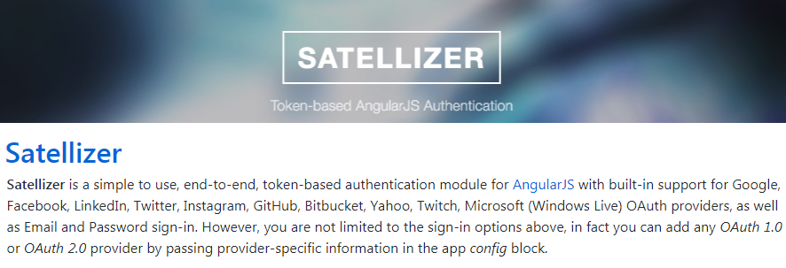
Application Registration
Satellizer
An end-to-end authentication solution
We will use it for logging in with an email and password, not total authentication

Slide 7
Application Registration
Programming Exercise06_03_01 – Step 3
Set Up Satellizer for Registration

Slide 8
Application Registration
Programming Exercise06_03_01 – Step 4
Create a Registration Endpoint with ExpressJS

Slide 9
Application Registration
Programming Exercise06_03_01 – Step 5
Save a User with MongoDB

Slide 10
Application Registration
Programming Exercise06_03_01 – Step 6
Associate a User with a Post

